Slide 1
Class on 11/19/16
Md. Khan

Slide 2
Some basics about QA
কয়েকটি পাখির নাম বল
উত্তর : কাক ইত্যাদি
Q1. Tell some browser’s name
Ans: Google Chrome, Mozilla Firefox, IE( Now Microsoft Edge), Opera, Torch and Safari
Q1. Tell me some computer OS (Operating System) Name
Ans: DOS (Disk Operating System)

Slide 3
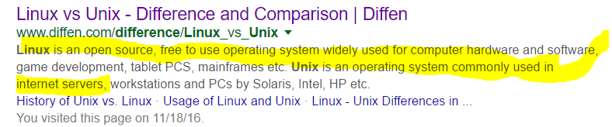
Windows (95, 98, 2000, XP, Vista, 7, 8 and 10)
Linux, Unix
Q3 : What is the difference between Linux and Unix
try with ss ??

Slide 4
Mobile’s OS Cont..
Q4. Tell me some mobile’s OS name
Ans:
Symbian OS (Property of Nokia)
Android (Property of Google , HTC, Samsung Galaxy)
Apple iOS : iPhone, iPod, iPad
BlackBary OS
Windows
BADA

Slide 5
একটি গল্প : আমার এক স্যার :-
Snipping toll
Paint (MS)
Prt Sc (Key)
Execution and Make Screen Print in Ms word with FR

Slide 6
একটি গল্প : লুঙ্গি
How Mustafa vhai is important?
How we can get maximum benefit from him?

Slide 7
Some important questions
What are the differences between Verification and Validation?
What are the differences between Smoke testing and Sanity Testing?
What are the differences between Test Plan and Test Strategy ?

Slide 8
What are the differences between walkthrough and Inspection?
What are the differences between Manual and Automation testing?
What is bug life cycle?
What is priority and severity?
How do you define or set priority and severity?

Slide 9
Give some example of low severity and high priority, high severity and low priority
What is entrance criteria and exit criteria?
Explain STLC very clearly
What is defect or bug? How do you entry/log a defect?
What is QA? What is the difference between QA and testing?

Slide 10
What is your strength and weakness?
How do you start your work everyday?

Slide 11
Home work

Slide 12
IEE-SA
The Institute of Electrical and Electronics Engineers Standards Association (IEEE-SA) is an organization within IEEE that develops global standards in a broad range of industries, including: power and energy, biomedical and health care, information technology and robotics, telecommunication and home automation, ...

Slide 13
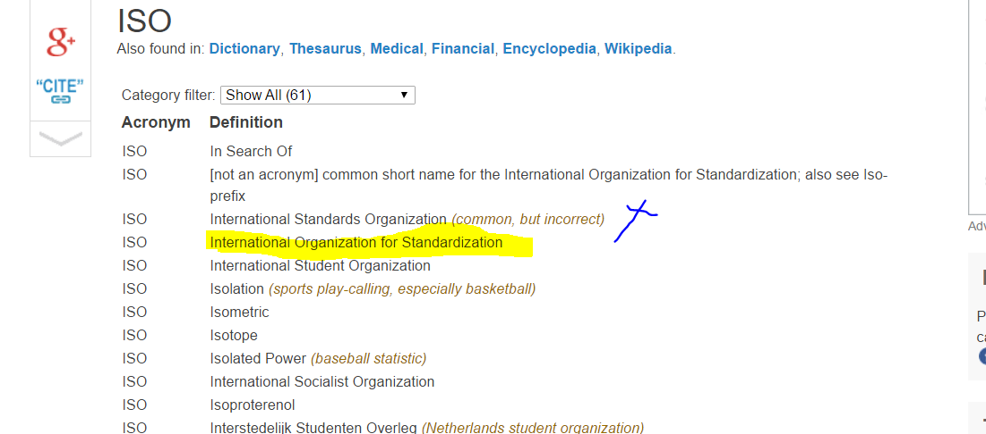
ISO

